Slide 1
Arduino uno introduction
Junk Yard Robotics
April 21, 2018

Slide 2
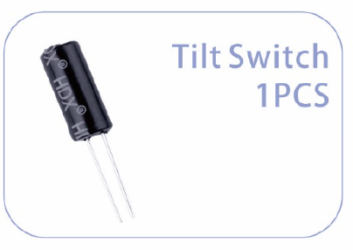
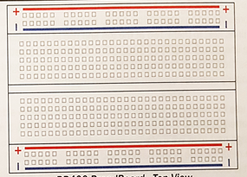
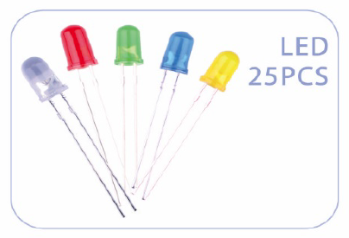
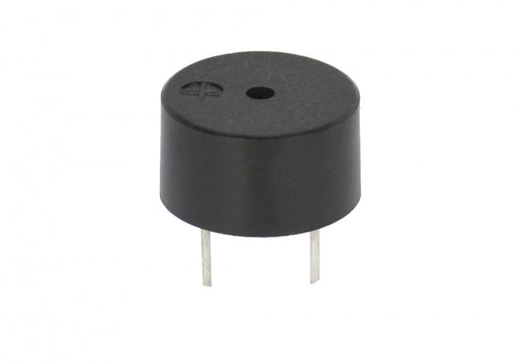
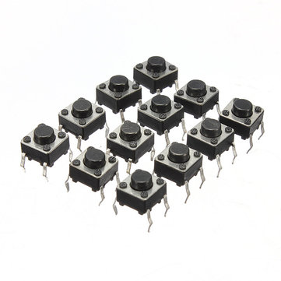
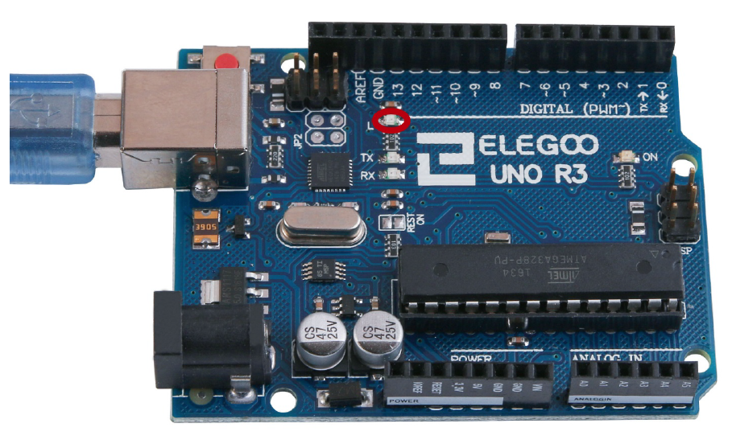
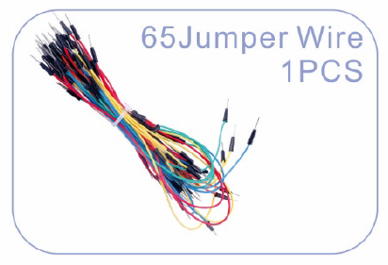
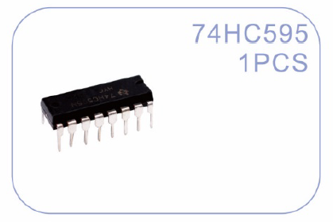
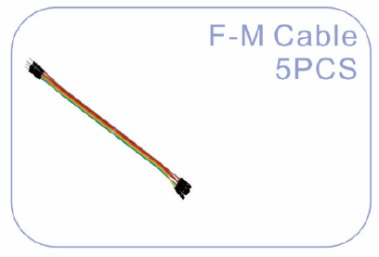
The main parts of your kit
A tilt switch
breadboard
resistors
Light emitting diodes (LED)
A buzzer
buttons
Arduino uno R3
Jumper wires
processor
F-m cable

Slide 3
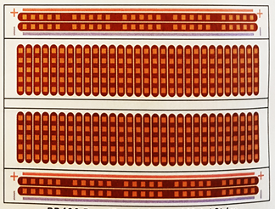
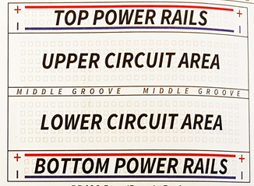
Breadboard structure
Top View
Interior View
Descriptive View

Slide 4
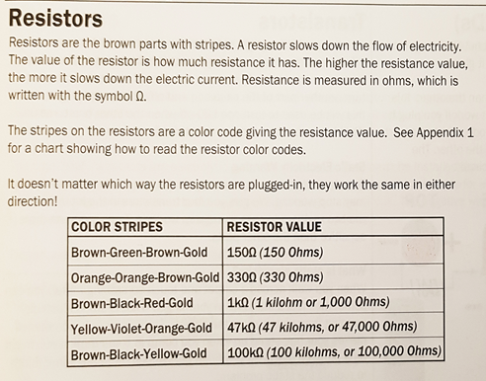
resistors

Slide 5
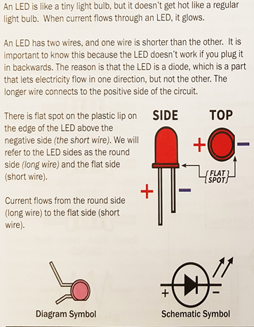
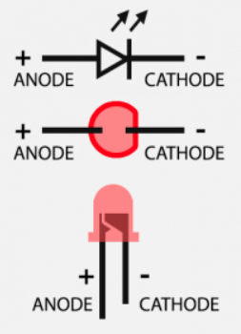
Light emitting diodes

Slide 6
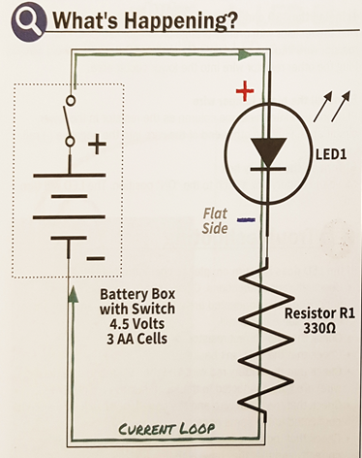
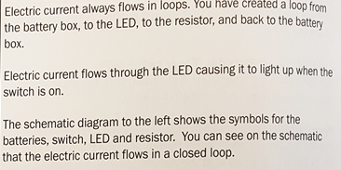
Electronic circuits and symbols

Slide 7
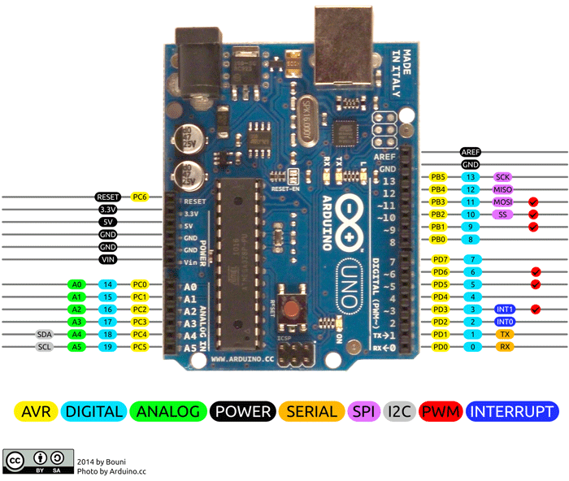
Electronic circuits and symbols

Slide 8
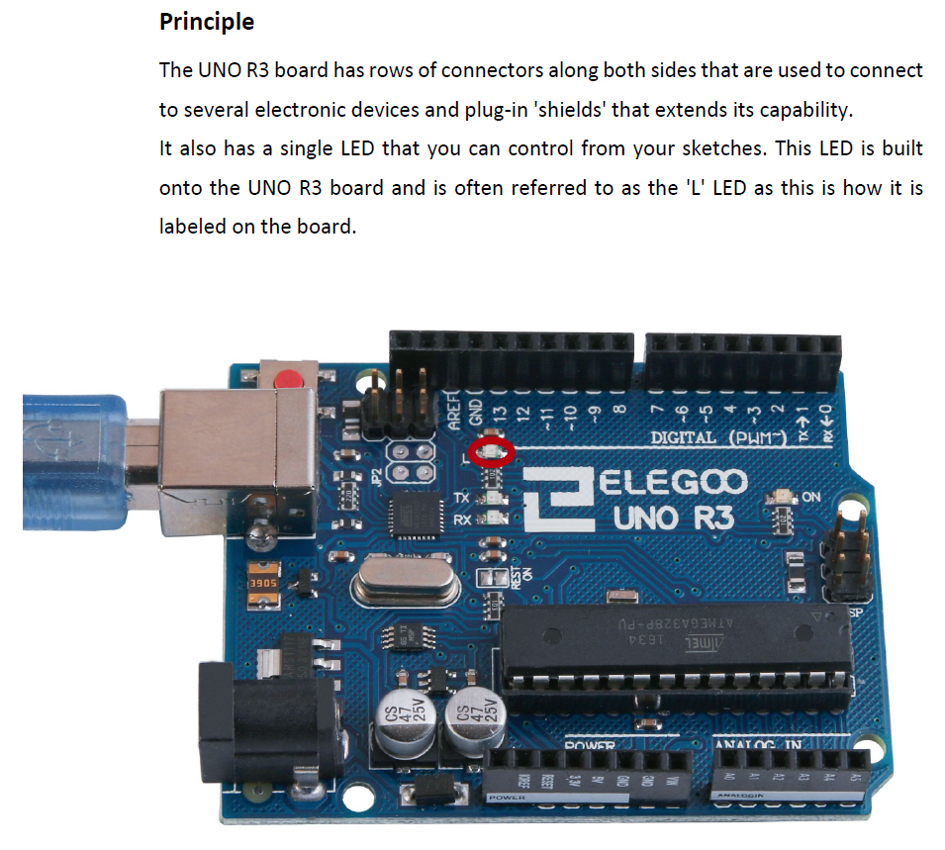
Arduino uno r3

Slide 9
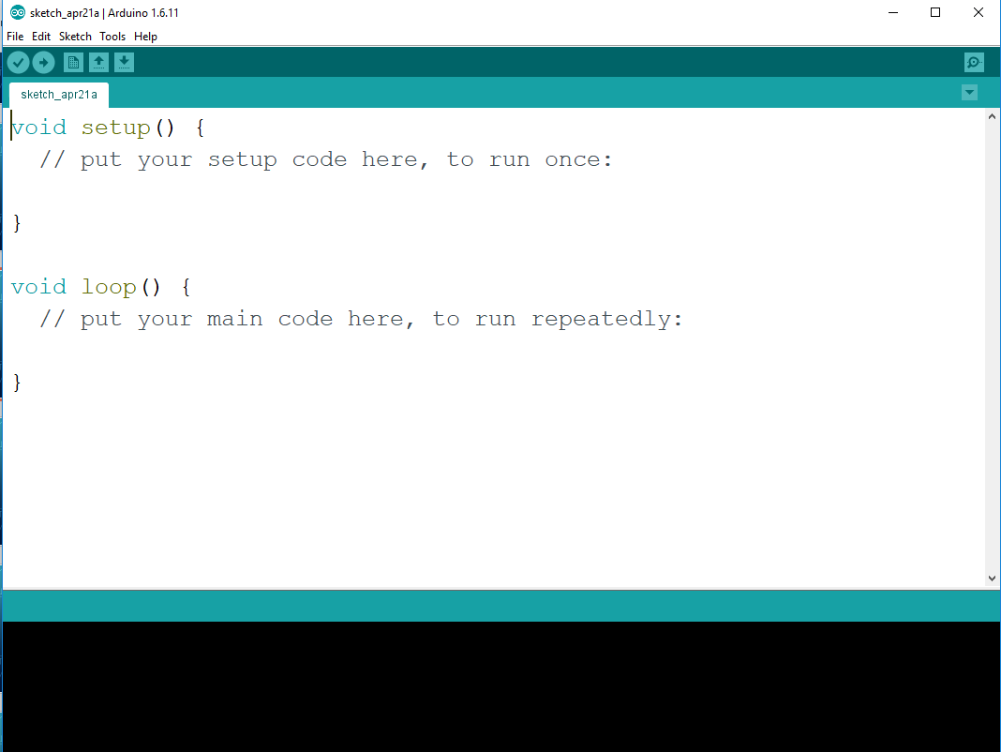

Slide 10
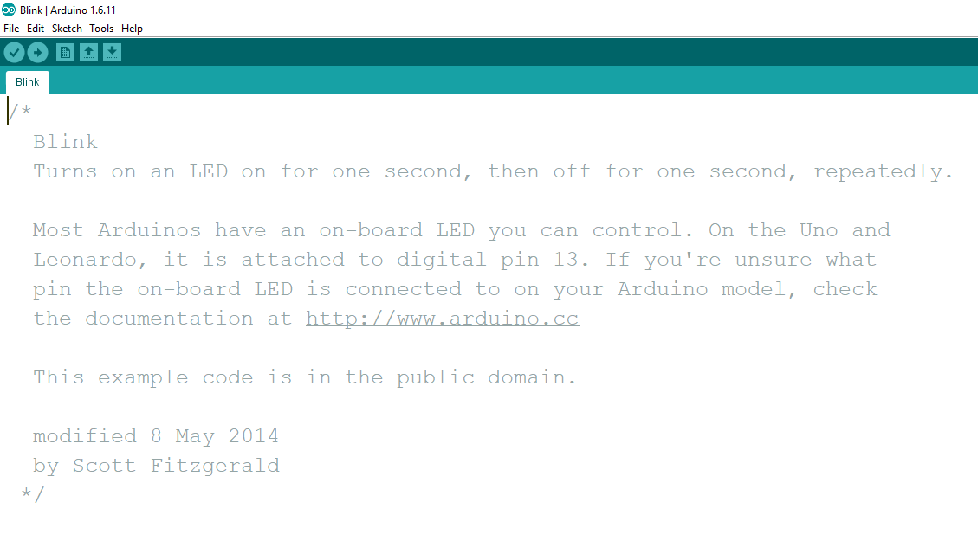
Electronic circuits and symbols

Slide 11
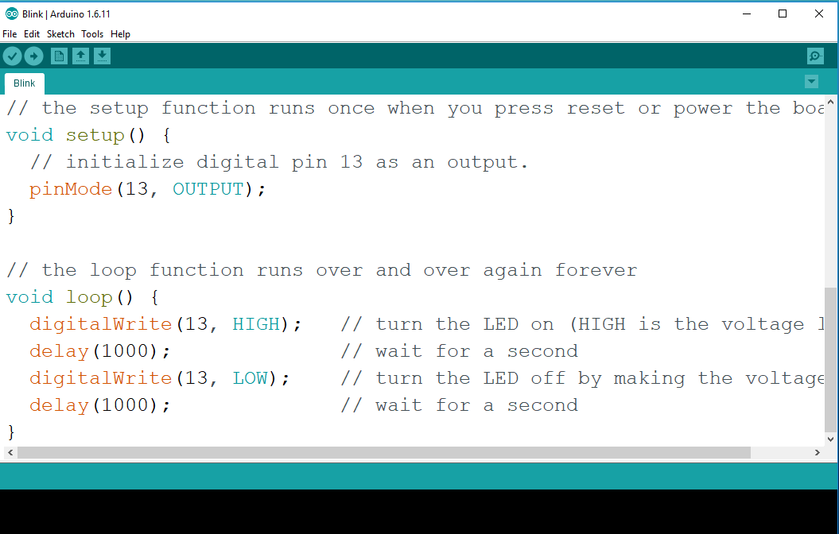

Slide 12
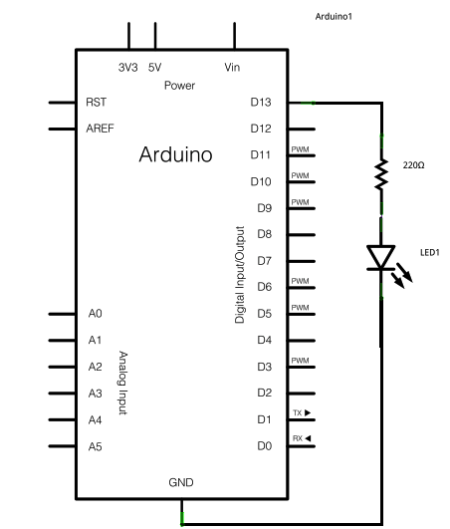
Blink code schematic

Slide 13
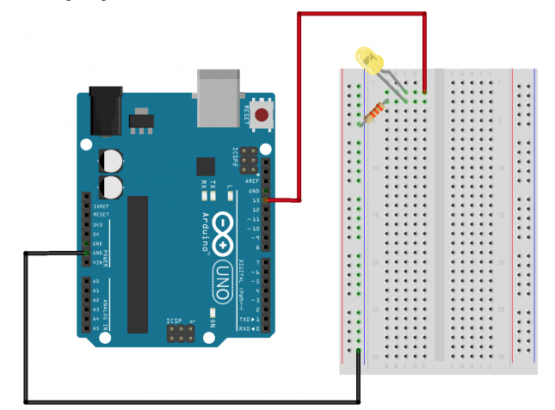
Building our first circuit and testing

Slide 14
challenge
Insert a jumper wire into pin 12
Connect another circuit to light an LED and call it LED2 in your code
Update your code to include
Add a delay in your code – choose the length of time you want the LED lit
Test to see if it lights
What do you notice?
Add another LED and call LED3
Connect to pin 11
Test
Repeat to add lights blinking in a row

