Slide 1
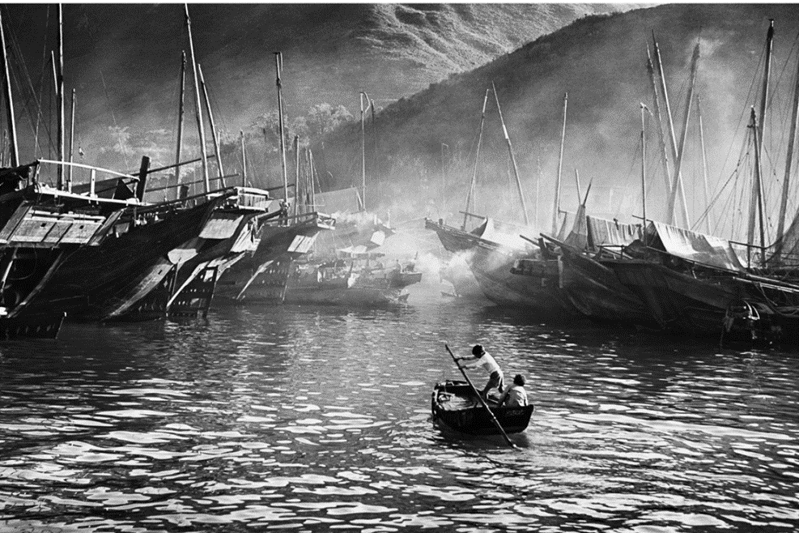
Historical Photos
Rebekah Raiche

Slide 2
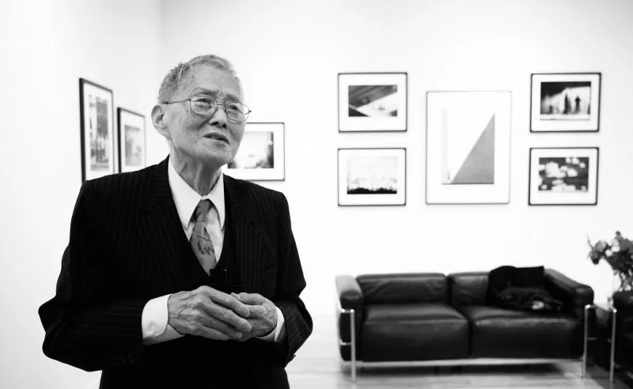
Fan Ho
Fan Ho was a photographer known for his amazing photos of 1950’s Hong Kong. He is often referred to as Hong Kong’s poet with a camera, this is because he loved Chinese poetry and draws much of his inspiration from it working it into his photos with a mystifying atmosphere. Fan Ho only ever used one camera, a classic Rolleiflex 3.5, type K4A. He had the camera since he was a young man when his father gifted it to him and he took all his photos using it. Before he made his mark with his camera he was better known by film as an actor. After 20 years of photography he went back to film, as an actor and director in over 20 films. Fan Ho died June 19th 2016 at the age of 84.

Slide 3
Afternoon Chat
Taken in 1959 this photo displays women chatting in what looks to me to be a subway tunnel in front of the entrance stairway where the natural sun light is shining through groups of people walking there. This created a diffused light that is an alluring display of rays that light the area around the dark dressed people at the base of the stairs making them stand apart from the other people in the photo. Arshdeep Matharu says the photo has a sense of mystery to it due to the child staring into the camera which happens to be at a low level around the child's eye level. Most find this to be a very intriguing photo.

Slide 4
People Crossing
Taken in 1957 this photo portrays people crossing a wide street in japan. The people appear as silhouettes giving the photo a wonderful light and shadow contrast. Their faces and destinations are undefinable, this creates the idea that on this street everyone is busy getting where they are going in their individual lives. This photo excellently portrays a glimpse into the 1950’s Hong Kong life style. A person can be seen carrying something on their head, there are few cars on the wide street and plenty of people walking, several public transport trains, and a great view of the tightly built stores with their many sings lining the street.

Slide 5
Pattern
Taken in 1956 this photo is rich with a sort of abstract pattern on a massive wall which happens to perfectly frame an interesting looking man. The man is walking while carrying a basket in the bottom center of the photograph. the contrast of the pattern to the man causes him to stands out a great deal. This makes you wonder about the man and the purpose of the basket creating an over all engaging photo. Clemens Eder exclaims that “The timing is simply perfect”. He is taken aback by Fan Ho’s impeccable timing.

Slide 6
Approaching Shadow
Taken in 1954 this image shows a shadow approaching a women with her back to a wall. The women is really the key to this photo with out her it is flat appearing as no more than a couple of colorless shapes but with the women added it gives the photo depth and brings out the illusion of the shadows. The large contrast and symmetry of the two triangles of light and lack there of makes this photo extremely easy on the eyes to say the least, it has an undeniable satisfying quality to it. Clemens Eder says this is his favorite photo by Fan Ho because of its simplicity. He admires it for its minimalistic style, so little having so much of an impact. Eder could not be more right, the composure of the woman in this simple scene Fan Ho has captured has the effect of making people wonder about what symbolism it could hold. Is the approaching shadow portraying a sort of impending doom or maybe the struggle of keeping a consistent glass half full point of view. This photo happens to be the only staged photo of Fan Hos, the featured women being his cousin.

Slide 7
East Meets West
Taken in 1963 this photo has a large industrial ship in the back ground and the silhouettes of two smaller vessels one a traditional ship and the other a small boat. The light in this photo divides the industrial vessel from the traditional ones. I think that without words this image tells the story of how Hong Kong was under British rule at the time. Britain ruled Hong Kong from 1841-1997 and many changes took place in the1960’s since it had become a trading center under British rule in the 1890’s. It was around the 1960’s that Hong Kong was in the process of becoming a developed country, the use of traditional Hong Kong ships were decreasing and the sight of industrialized fishing boats and cargo ships were becoming increasingly common. Hong Kong became developed in 1970-1980. Modern times review states that Fan Ho was a master of patience, care, and time, and that he lets the photo create itself and then preserves it. This photo was taken without any interference from Fan Ho, he has a talent of capturing natural moments that say so much.

Slide 8
Lines and form
Taken in 1959 the tittle of this photo says it all. Fan Ho has captured a scene with an abundance of lines and form, two of the seven elements of art which are skillfully applied in this shot. The base of this photo is made up of several lines and pillars bending with the road on top of all that there is a driving vehicle and a walking man carrying baskets. If you were to imagine this photo without its live subjects it would be quite flat and empty Fan Ho seems to have an eye for where and when a live subject should be. Though the live subjects give life to his photo its most defiantly the lines and form that make the photo as Fan Ho has pointed out through the title. The lines and form of the photo make the subjects seem closed off from the rest of the world for the moment and gives quite a nice mood to the photo. Clemens Eder says in his review of Fan Hos’ photography book that this photographer is a true master when it comes to using lines in his pictures, this is an undeniable fact of Fan Hos skill.

Slide 9
Her study
Taken in1963 this photo is of a young child clearly hard at work doing her studies outside on a small balcony. The photo is framed with shadow making it appear as though we’re looking through a window at the child's own little world. This effect gives the photo a whimsical sense. Inside the shadowy frame the image is well lit and has lots of depth. Selina Cheng describes Fan Ho as a master of photography and uses this photo along with others as examples of his skill.

Slide 10
private
Taken in1960 it is hard to believe this photo was found by Fan Ho and not staged. It has a romantic sense to it that would be obvious to anyone. Not only did he perfectly capture a man and woman’s silhouette in the window he was also able to get a sign that reads private to add to mystery of the man and woman. To add to the obvious appeal of this photo he has perfectly balanced the sign to the window and the wall of the building is lit to perfection. Selina Cheng says that Fan Hos old Hong Kong photos are the nostalgic scenes that remind us of Wong Kar Wai’s (In the Mood for Love).

Slide 11
Sources
http://erickimphotography.com/blog/fan-ho/
https://www.theguardian.com/artanddesign/gallery/2014/aug/20/fan-ho-hong-kong-street-photography-in-pictures
https://qz.com/714123/hong-kongs-perfect-serenity-before-it-was-a-financial-hub-by-master-photographer-fan-ho/
https://www.moderntimes.review/fan-ho-the-roaming-street-photographer/

